Slide 1
Surface Tension Experiment

Slide 2
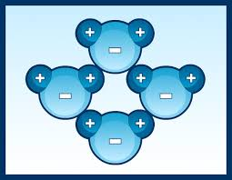
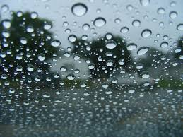
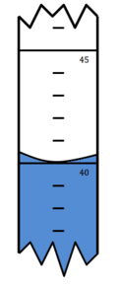
What is Surface Tension?
Surface Tension = Where molecules of one substance are more attracted to each other than molecules of another substance.
These molecules ‘stick together’ as they move, so they group more with each other.
Causes water to form beads on a glass surface.
Causes water to curve up within glass surfaces = Meniscus

Slide 3
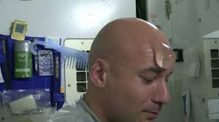
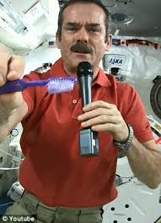
Astronauts hygiene and water surface tension
Water bunches up on this astronaut
as he is washing his scalp.
Water sticks or stays on this toothbrush
before the astronaut brushes his teeth.

Slide 4
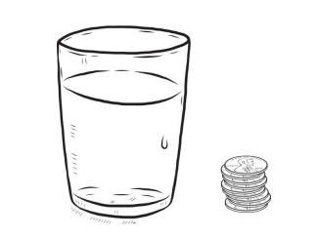
Surface Tension Experiment with Pennies and Bottle Caps
Add water droplets to a cap (cup) and top of pennies until they form a nice dome.
See how many total drops you can add before the dome collapses and water spills everywhere.
Keep track of the total number of water droplets you put on the pennies and caps.

